Slide 1


Software Quality Engineering (Week-2)
Usama Musharaf
LECTURER (Department of Computer Science)
FAST-NUCES Peshawar

Slide 2
Content of Week # 2
Quality Aware Development Processes
Agile Development (Scrum)
DevOps
Quality Engineering at Requirement Phase
Requirement Document
RE related Activities
Requirement Traceability Matrix

Slide 3
Agile Development

Slide 4
What is “Agile”?
Agile is a philosophy or a way of thinking guided by some values and principles.

Slide 5
What is “Agility”?
Effective (rapid and adaptive) response to change
Effective communication among all stakeholders
Yielding …
Rapid, incremental delivery of software

Slide 6
Agile values
Individuals and Interactions over Processes and Tools
Working Software over Comprehensive Documentation
Customer Collaboration over Contract Negotiation
Responding to change over Following a Plan

Slide 7
Principles of agile methods

Slide 8
SCRUM
Scrum is an Agile framework for completing complex projects.
Scrum originally was formalized for software development projects, but it works well for any complex, innovative scope of work.
Scrum is a team-based approach, to iteratively, incrementally develop systems and products.
when requirements are rapidly changing .

Slide 9
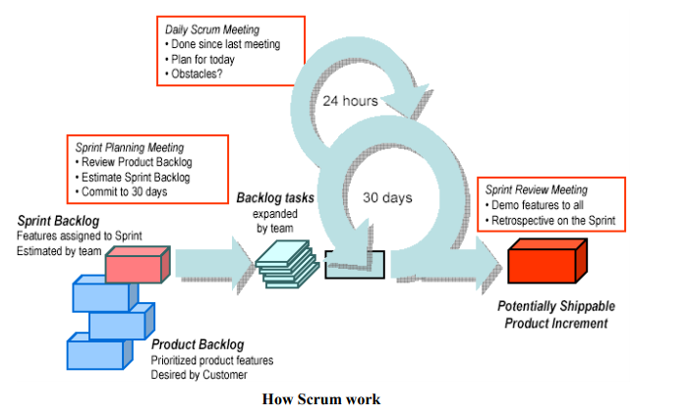
How does SCRUM work?

Slide 10
User Stories
User Story Format
As a (user or type of user)
I want a (some goal or what)
So that ( I can achieve some value or why)
User Story capture 3 important items
Who
What
Why

Slide 11
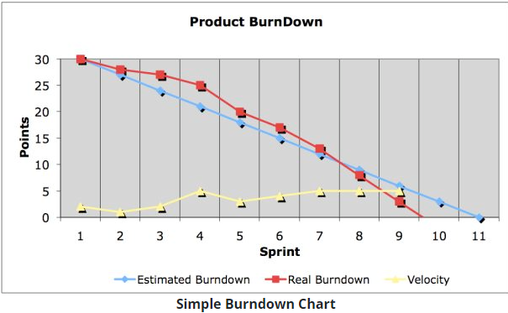
Burndown chart

Slide 12
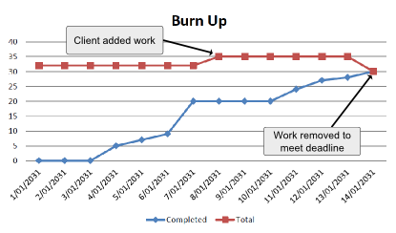
Burn up chart

Slide 13
DevOps

Slide 14
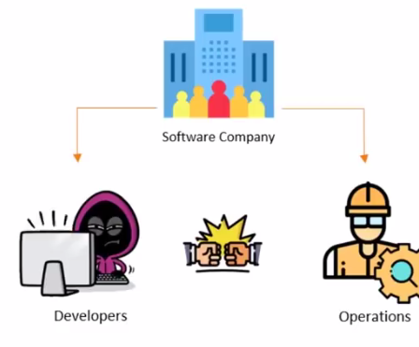
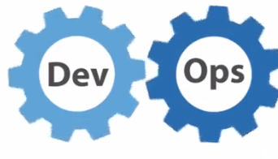
DevOps

Slide 15
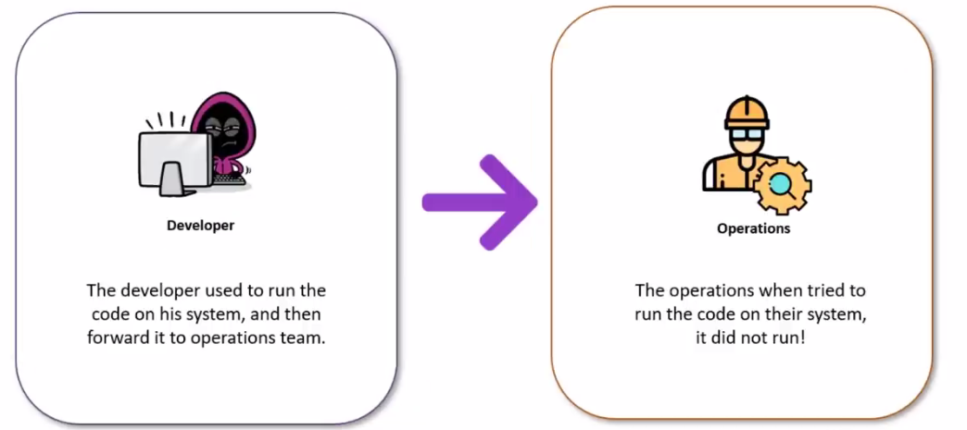
Why Devops

Slide 16
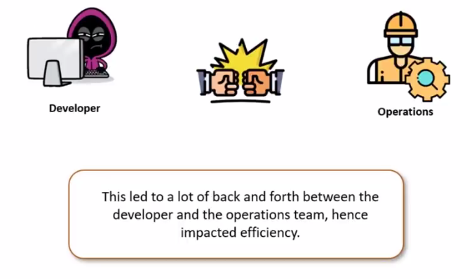
Why Devops

Slide 17
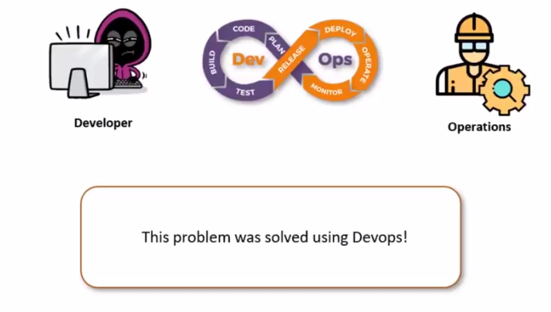
Why Devops

Slide 18
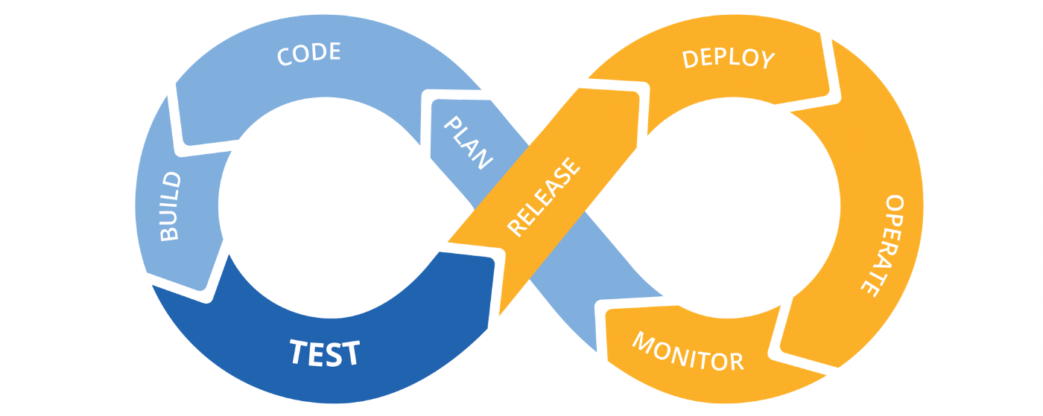
Devops
What is DevOps
DevOps assimilates development and operations teams to improve the collaboration process.
A DevOps Engineer will work with IT developers to facilitate better coordination among operations, development, and testing functions by automating and streamlining the integration and deployment processes.

Slide 19
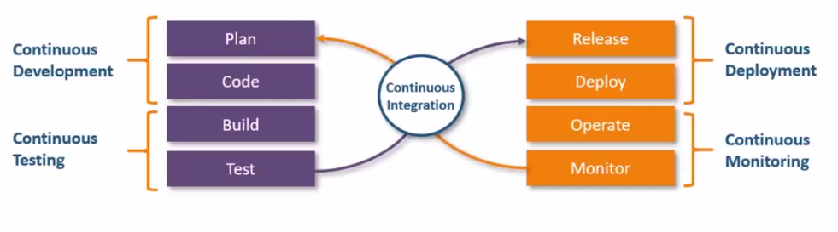
How Devops Work
The DevOps life cycle divides the SDLC into the following stages.

Slide 20
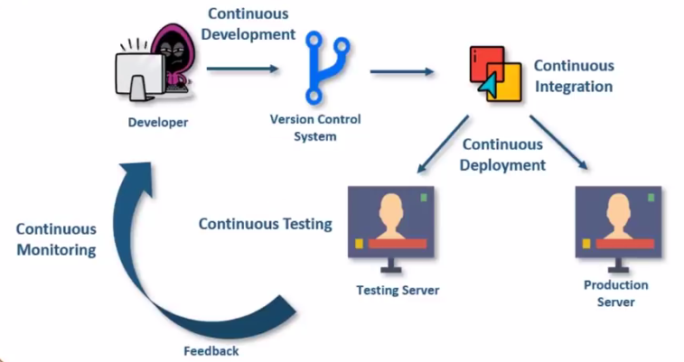
How Devops Work

Slide 21
Software Quality Engineering at Requirement Phase

Slide 22
Software Quality Engineering Road Map
Quality Engineering at every SDLC phase:
Quality Engineering
Requirement Analysis
Quality Attributes
Design
Version Controlling
GIT, GIT Hub
Code
Unit Testing
(JUnit)
Testing
Docker Containers
Defects
Deployment

Slide 23
The Requirements Process (Process for Capturing Requirements)
Performed by the req. analyst or system analyst
The final outcome is a Software Requirements Specification (SRS) document

Slide 24
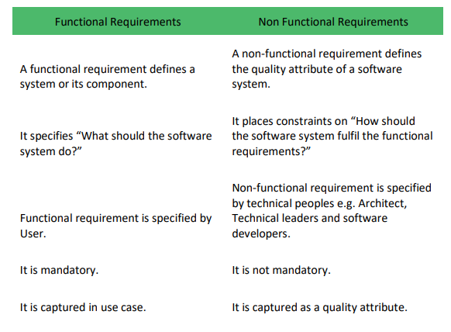

Slide 25
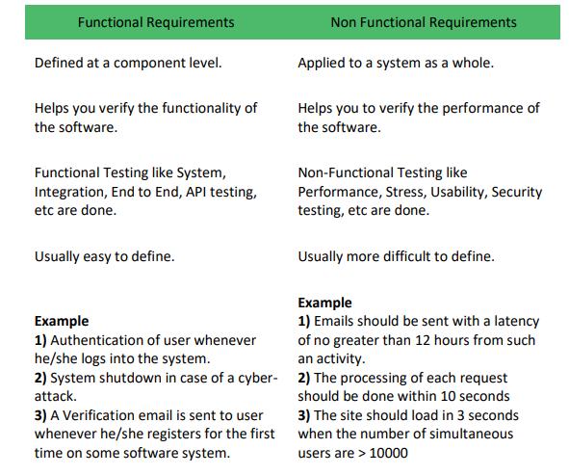

Slide 26
What is Defect?
Defect is deviation from customer requirement.
Mostly defects are found in the software after software is shipped to the customer at production site.
Example:
In online shopping, the option of searching a debit card for making payment is missing.

Slide 27
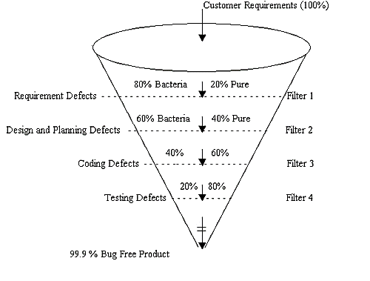
Defects

Slide 28
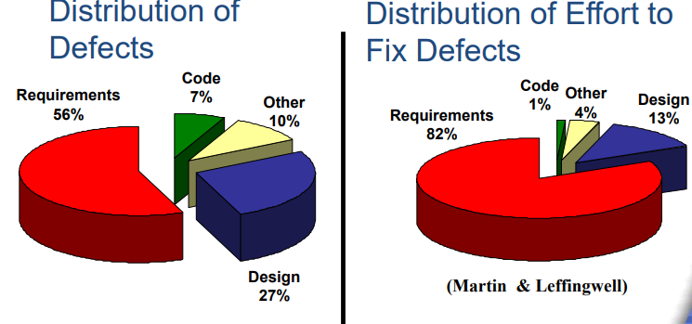
Distribution of Defects

Slide 29
Failure Root Cause
Standish Group in 1994 study three most commonly factors that cause projects to be challenged
Lack of User Input
Incomplete Requirements & Specification
Changing Requirements and Specification

Slide 30
Failure Root Cause
Standish Group Study in 1994:
Observation for Failure: Why 1/3 Projects run in trouble, it is directly related to
Requirements Elicitation
Requirement Documenting
Requirement Management
Standish Survey: Coding issue were a “non-problem.

Slide 31
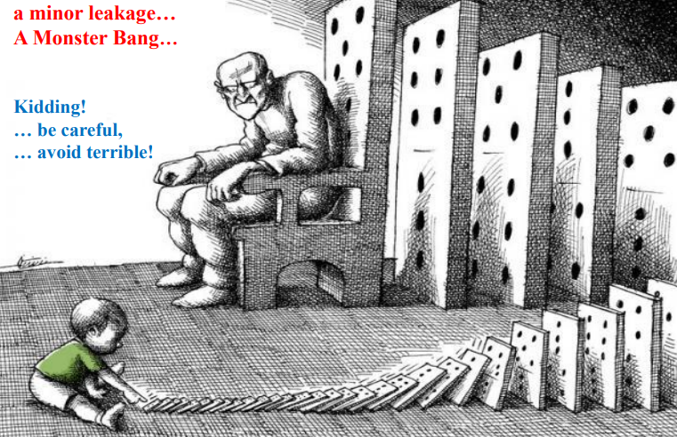

Slide 32
Impact of Requirement Defects
Leakage into other phases
Design, Code, Implementation, Maintenance etc.
Impact
re-requirement,
re-design,
re-code,
Re-testing,
re-implementation,
re-deployment, re-training .
increase cost, extra support & service cost.

Slide 33
What are Missing Quality Requirements?
In a real-time scenario, more budgets mean more quality. This is both theoretically and practically true.
Putting in more money for quality of the software product will result in low probability of product failure and may save a lot of financial resources as the high quality product will be immune to threats.
Prioritize areas which are non-negotiable.
For example, a software product with excellent User Interface (UI) but with no firewall for database security will face more threats. So adding a firewall to ensure Database is secure is more important than spending budget on cosmetic changes in UI.

Slide 34
Missing Quality Requirements
Lack of quality in any product can lead to massive losses but when we talk about lack of quality in software products, we can expect catastrophe. One such scenario occurred when Hackers access personal information associated with at least a half billion Yahoo accounts. This incident was report in 2016 but occurred sometime in late 2014.
What was the ramification? Prior to the announcement of the breach, Verizon negotiated and decided to purchase Yahoo for $4.8 billion and this deal was to be closed in March 2017. But later in February 2017, Verizon and Yahoo announced that the deal will still go forward, but dropping the sale price by $350 million.
On the other side, user’s confidential information including email, credit card details, bank account details and many others hit the market putting millions of users on stake

Slide 35
Cost Analysis based Approach
Missing Quality in Software Application has direct impact on People and Organizations as seen by the example mentioned previously.
According to Eppler and Helfert principles the costs are classified in two categories:
Direct Cost of missing Quality
In-Direct Cost of missing Quality:

Slide 36
Cost Analysis based Approach
Direct Cost of missing Quality
Direct Costs, as the name suggest, are directly linked to the missing quality. The direct costs are effects that are easily observable/measureable and they occur immediately after any unfortunate event. Examples includes; financial loss & physical injury and related. In short, direct costs are visible and measureable.

Slide 37
Cost Analysis based Approach
Indirect Cost of missing Quality
Indirect Costs are invisible cost of missing quality and hence difficult to calculate. It is also, sometime, difficult to realize or identify as they occur after a long time of the incident. Example includes: Loss of market share or reputation, loss of market and shareholders trust and investment. Opposed to the direct cost, these are invisible as they may remain hidden for pretty long time, may have long-term impact as well.
Scenario of Nokia serves a good example, its CEO said in May-2016 in his farewell speech: “We didn’t do anything wrong but somehow we Lost”.

Slide 38
RE Related Activities
Functional Requirements: describes what a software system should do
Non-Functional: place constraints on how the system will do so.
Business Processes: procedure or event with the purpose of reaching a goal
Scope: required tasks to accomplish, boundary of system
Goals: An observable and measurable end result having one or more objectives to be achieved within a more or less fixed timeframe
Stakeholders: person, group or organization that has interest or concern in an organization
Sources: someone or something that provides what is wanted or needed i.e. human, documents, context, situational factors, application types etc.
Feasibility study: a feasibility study is an analysis of the viability of an idea

Slide 39
RE Related Activities
GUI: Graphical User Interface
Traceability: concerned with documenting the relationships between different development artifacts (i.e. requirements and other artifacts).
Measureable: objectives should be measurable and achievable
Domain: area, business, discipline, field, realm, sphere
Prototyping: An easily modified and extensible model (representation, simulation or demonstration), partial or approximation of final product, useful for clarifying requirement.

Slide 40
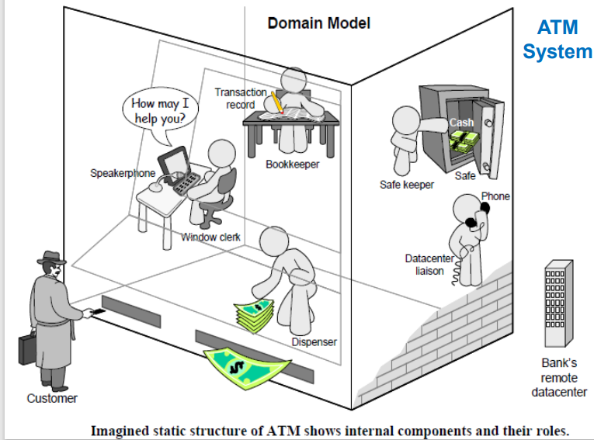

Slide 41
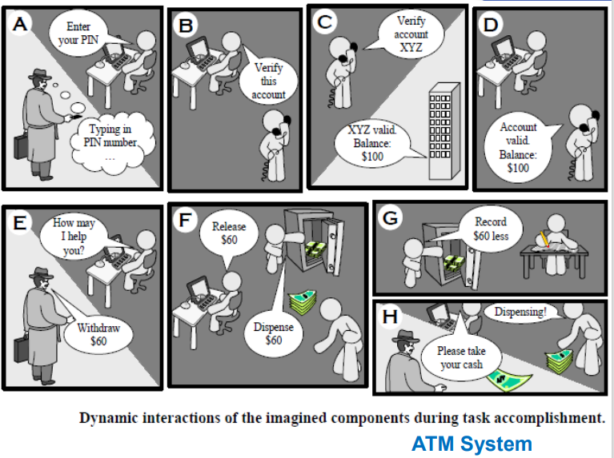

Slide 42
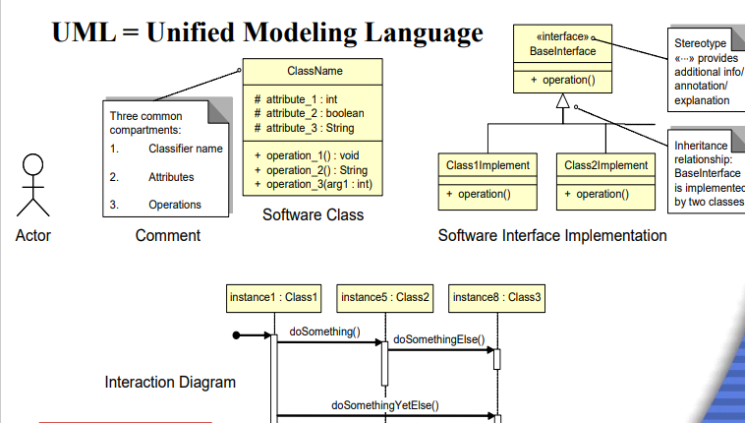

Slide 43
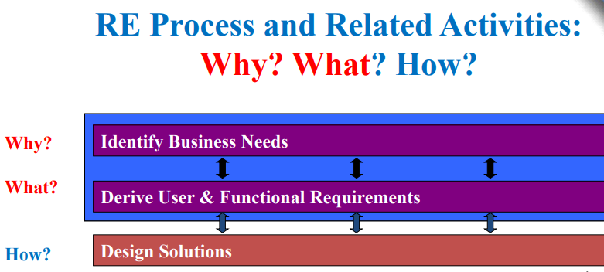

Slide 44
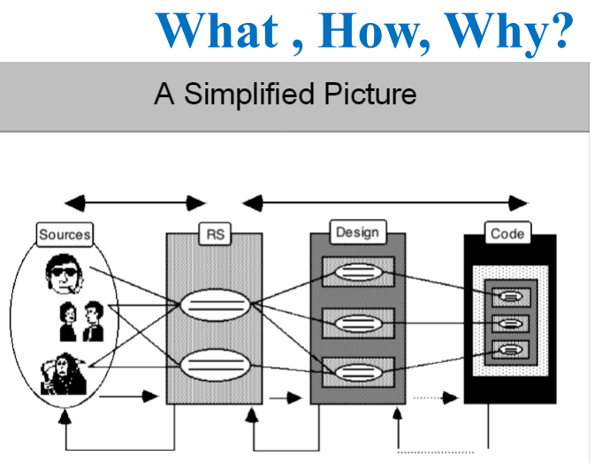

Slide 45
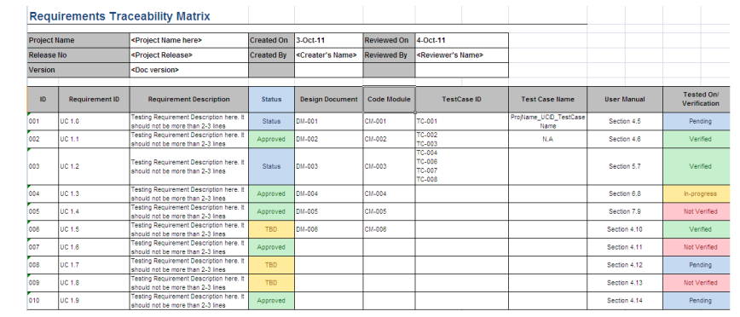

Slide 46
Assignment # 1
Requirement Document Template
As a software quality engineer, You have to bring quality in the software development process right from the beginning. Your task is to create a requirement document template that should be ideal for capturing requirements in a better way.

Slide 47
HAVE A GOOD DAY !

